Slide 1



Fundamentals of T-SQL Language
Eduardo Pivaral (MCSE, MCSA) – Feb 2019

Slide 2







Eduardo Pivaral MCSE, MCSA SQL Server DBA/Developer
www.SQLGuatemala.com
Eduardo Pivaral
@EduardoDBA
Epivaral
+15 Years of experience working on IT, +10 Years of experience working with SQL Server
Author for different sources (MSSQLTips.com, SQLServerCentral.com)
Developer of Open Source tools for SQL Server administration, development and productivity.
Board member of PASS Guatemala SQL Server users group.
MSSQLTips.com Rookie of the year 2018

Slide 3

AGENDA
How SQL Server engine works?
Understanding execution plans
Best practices when working with data
Advanced T-SQL
DEMOS

Slide 4

How SQL Server Engine Works?

Slide 5
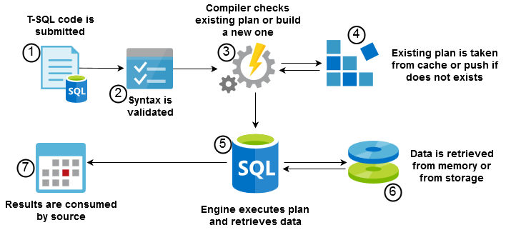
T-SQL is a Declarative Language: We instruct WHAT to do, engine decides HOW to do it.

Slide 6
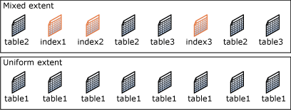
Page: The fundamental unit of data storage
Size is 8-KB
128 pages per megabyte
Extent: Eight physically contiguous pages
64 KB
16 extents per megabyte
Page activity from disk or memory on any T-SQL sentence:
SET STATISTICS IO ON;

Slide 7
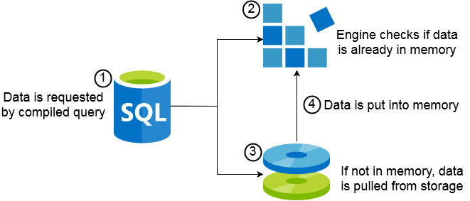
Check data in memory:
SELECT * FROM sys.dm_os_buffer_descriptors;
Clear data from cache (data will be pulled from storage again):
DBCC DROPCLEANBUFFERS;

Slide 8

Understanding Execution Plans

Slide 9
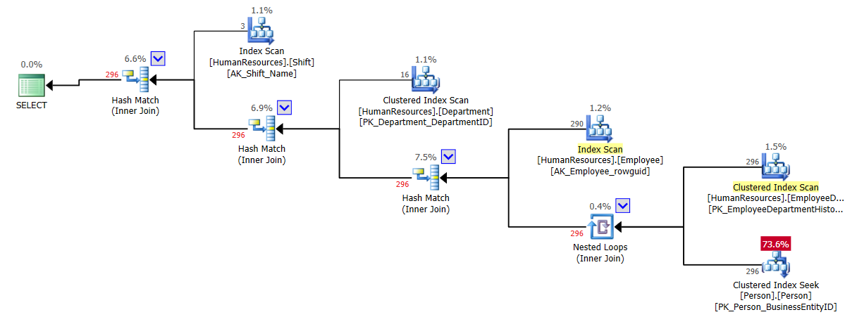

Are the results of SQL declarative language
It is a calculation of most efficient way to execute a query
For poor performing queries, it should be the first thing to check
https://www.sentryone.com/plan-explorer

Slide 10
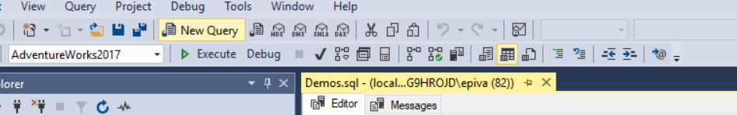
Estimated Plan is how a query will be executed based on existing indexes, statistics and server load at request moment.
Actual plan include run time statistics (number of rows processed) to the execution plan information.
For most cases, Estimated and Actual plan will be the same.
Estimated Plan
Actual Plan
Clear plan cache (all plans will be compiled again):
DBCC FREEPROCCACHE;

Slide 11

Best Practices When Working With Data

Slide 12


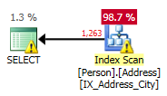
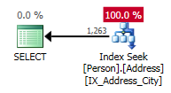
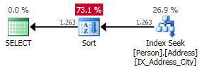
Avoid using SELECT * to send data to client application
Check required time to parse, compile, and execute a statement:
SET STATISTICS TIME ON;
Filter data on the database tier
SARGABLE: search +‎ argument +‎ -able
Sort data on presentation tier
Sorting is an expensive operation

Slide 13
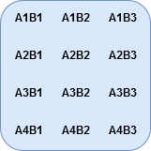
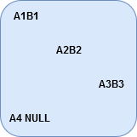
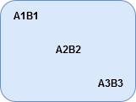
SELECT A FROM X
UNION [ALL]
SELECT B FROM Y
SELECT A FROM X
INTERSECT
SELECT B FROM Y
SELECT A FROM X
EXCEPT
SELECT B FROM Y
SELECT X.A, Y.B
FROM X INNER JOIN Y
ON X.A = Y.B
SELECT X.A, Y.B
FROM X LEFT OUTER JOIN Y
ON X.A = Y.B
SELECT X.A, Y.B
FROM X CROSS JOIN Y

Slide 14

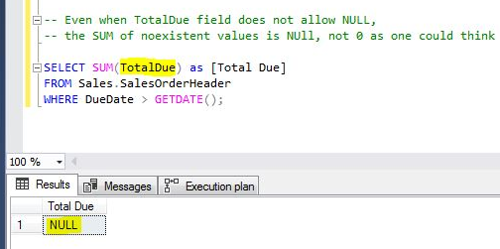
Grouping functions:
GROUP BY
OVER PARTITION BY
OVER ORDER BY
OVER ROWS
OVER RANGE
GROUPING SETS
NULL
NULL
COUNT(field) <= COUNT(*)
Be careful with aggregations over non-existent data

Slide 15
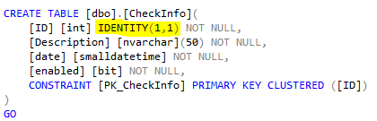
INSERT
INSERT INTO
INSERT SELECT
INSERT EXEC
SELECT INTO
UPDATE
UPDATE VALUES
UPDATE FROM
DELETE
DELETE WHERE
DELETE FROM
TRUNCATE TABLE
MERGE
MERGE INTO
WHEN MATCHED
WHEN NOT MATCHED
WHEN NOT MATCHED BY SOURCE
IDENTITY auto generate sequential numbers (ideal for primary keys)
Allowing Identity Insert:
SET IDENTITY_INSERT <table_name> ON;
OUTPUT allows you to watch modified rows info:
OUTPUT inserted.[field] -- Inserted or after update data
OUTPUT deleted.[field] -- Deleted or before update data

Slide 16

Advanced T-SQL

Slide 17
Programmability Object | Syntax
Subqueries | SELECT X.a FROM ( SELECT i as a FROM Table1 X );
Common Table Expressions | WITH [name_CTE] AS (SELECT a,b FROM TableA) SELECT I.a, I.b FROM [name_CTE];
Stored Procedures | CREATE PROCEDURE [Proc_name] @param1 int = 0 AS SELECT @param1 RETURN 0;

Slide 18
Programmability Object | Syntax
User Defined Functions (UDF) Scalar Inline (Table valued) Multi-statement (Table valued) | CREATE FUNCTION [FunctionName] ( @param1 int ) RETURNS…
CROSS APPLY OUTER APPLY | SELECT X.*,CA.* FROM X [CROSS|OUTER] APPLY f(X.a) CA;

Slide 19



Temporary tables | Remarks
#Table1 | Session Scoped temporary table, resides in tempdb Affected by transactions
##Table1 | Global temporary table, resides in tempdb Affected by transactions
@Table1 | Table variable, only resides into memory Not affected by transactions

Slide 20

ACID (Atomicity, Consistency, Isolation, Durability)
Transaction Syntax | Description
BEGIN TRANSACTION; | Starts explicit transaction. Increment @@TRANCOUNT in 1
COMMIT TRANSACTION; | Commits explicit transaction. Decrement @@TRANCOUNT in 1
ROLLBACK TRANSACTION; | Rollbacks explicit transaction. Decrement @@TRANCOUNT in 1
Isolation Levels
Isolation
Serializable
Repeatable Read
*Read Committed
Read Uncommitted
Pessimistic
Autocommit Transactions: By statement and controlled by engine automatically.
If an error occurs or session is cancelled, the sentence is rolled back
Concurrency
Optimistic

Slide 21

SQL Server Locks
Checking locks: sys.dm_tran_locks
Lock Hierarchy
Database
Table
Page
Row
Lock Mode | Description
Shared (S) | Operations do not modify data
Update (U) | Operations could modify data
Exclusive (X) | Operations are modifying data
Intent (IS, IX) | At compile moment, used to determine lock scalations
Schema (Sh-M, Sh-S) | Prevents schema modifications at execution or to ensure stability at compiling time
Bulk Update (BU) | Table locks for bulk operations
Deadlock: when concurrent sessions require exclusive lock to the same object, the least expensive operation is rolled back by engine.
Lock Escalation

Slide 22


Error Handling
It is a best practice to re-throw errors to client with custom messages, SQL Server have 2 functions for this:
BEGIN TRY
-- code to verify
END TRY
BEGIN CATCH
-- error handling block
-- error functions:
SELECT
ERROR_LINE(),
ERROR_MESSAGE(),
ERROR_NUMBER(),
ERROR_PROCEDURE(),
ERROR_SEVERITY(),
ERROR_STATE()
END CATCH;
Command | Description
THROW [Error_number],[Message],[State]; | Fixed severity of 16 Always activates CATCH block
RAISERROR([Message],[Severity],[State]); | Supports log to Application Log Activates CATCH block for severity >10
TRY..CATCH does not capture compilation errors or errors by killed sessions.

Slide 23

DEMOS

Slide 24

Thank you!
Want to know more? Having doubts about this presentation?
Visit me at:
www.SQLGuatemala.com
Eduardo Pivaral
@EduardoDBA
Epivaral

